Slide 1
Lesson 16 – Homework review

Slide 2
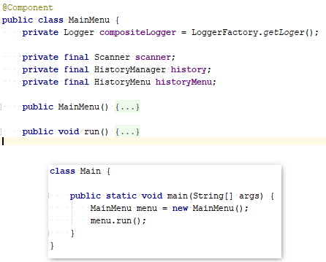
Do not use IoC annotations if not required

Slide 3
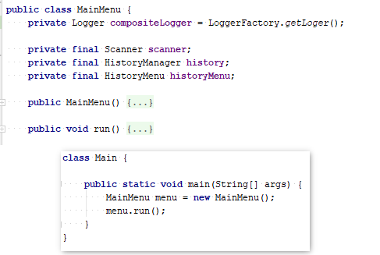
Do not use IoC annotations if not required

Slide 4
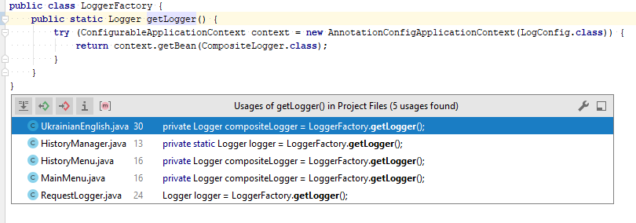
Do not create ApplicationContext more than once

Slide 5
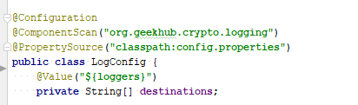
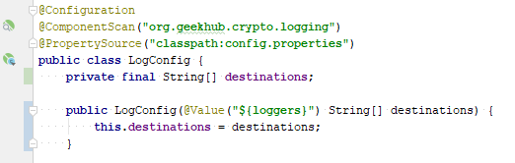
Use injection via constructor

Slide 6
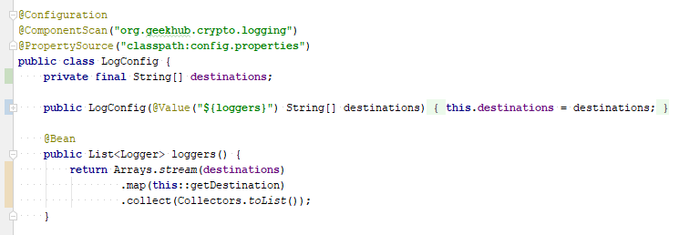
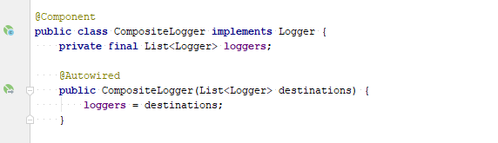
Do not make List as Spring bean

Slide 7
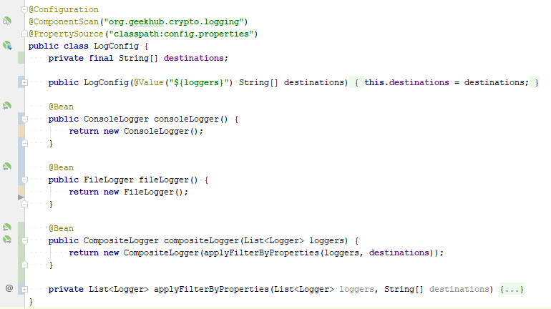
Do not make List as Spring bean

Slide 8
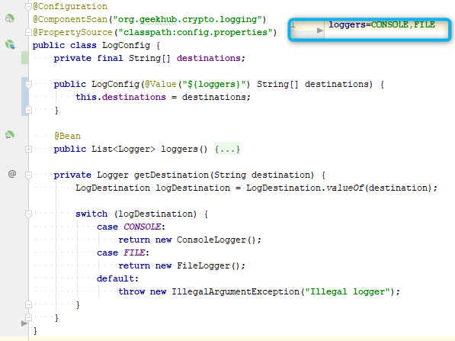
Simplify properties usage for bean creation

Slide 9
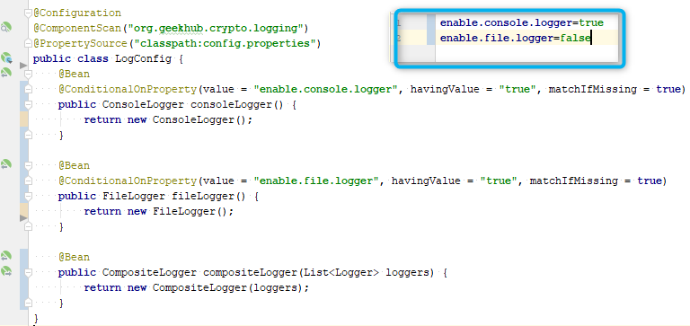
Simplify properties usage for bean creation

Slide 10
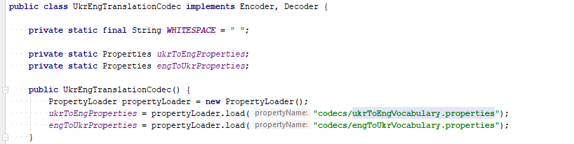
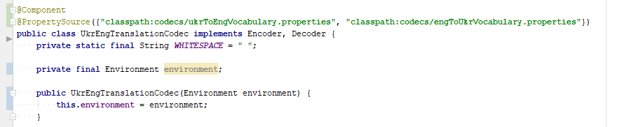
Load properties by Spring

Slide 11
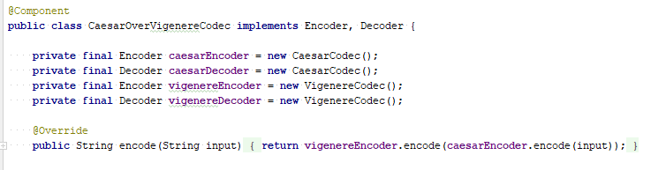
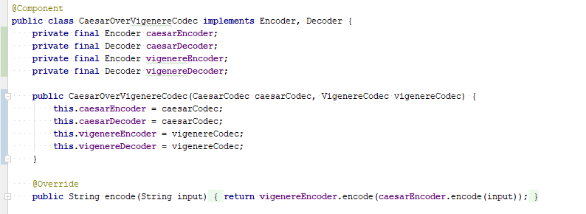
Do not create classes manually

Slide 12
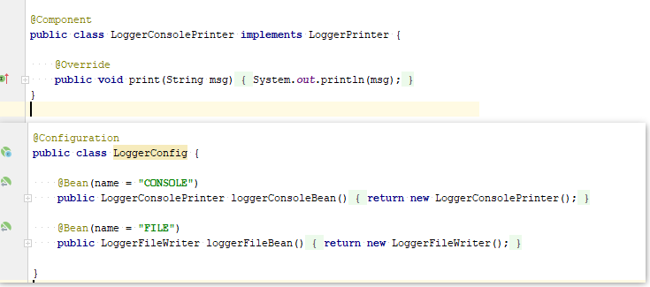
Do not create components twice

Slide 13
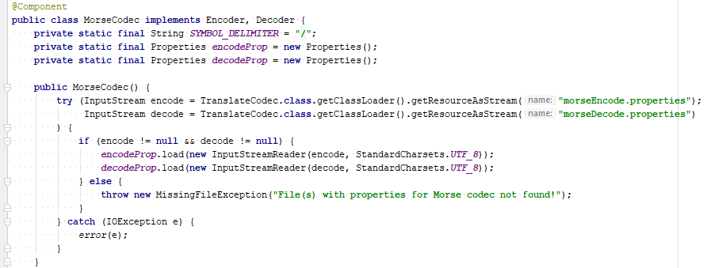
Do not fill static fields in constructor

Slide 14
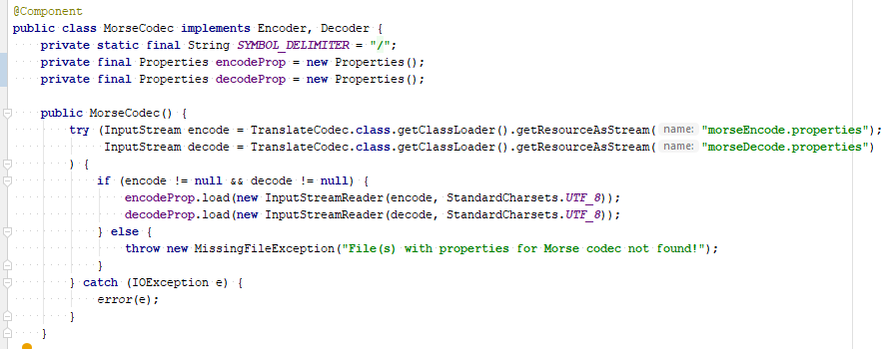
Do not fill static fields in constructor

Slide 15
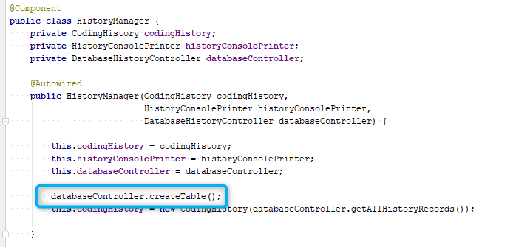
Do not init database in component’s constructor

Slide 16
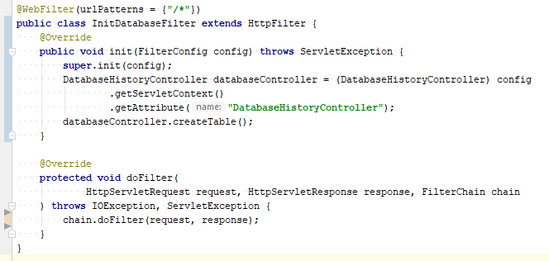
Do not init database in component’s constructor

Slide 17
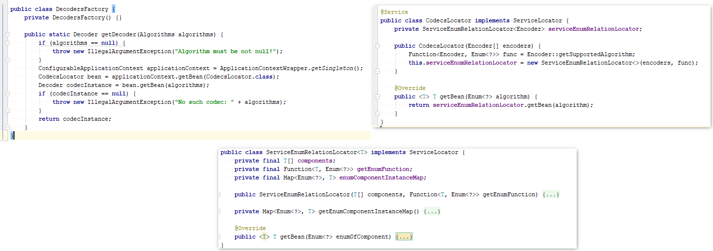
Do not do overhead (KISS)

Slide 18
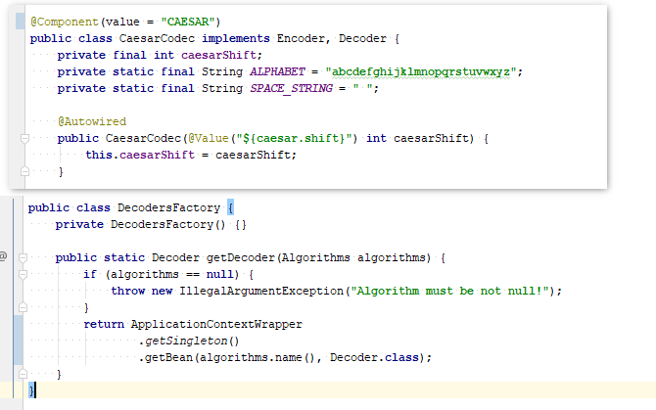
Do not do overhead (KISS)

Slide 19
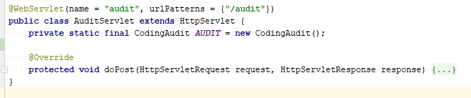
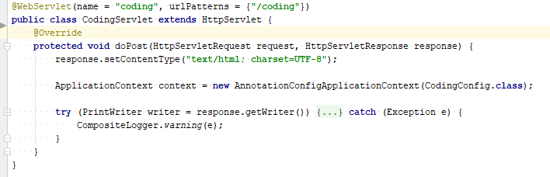
Init ApplicationContext once/injection into servlet or filter

Slide 20
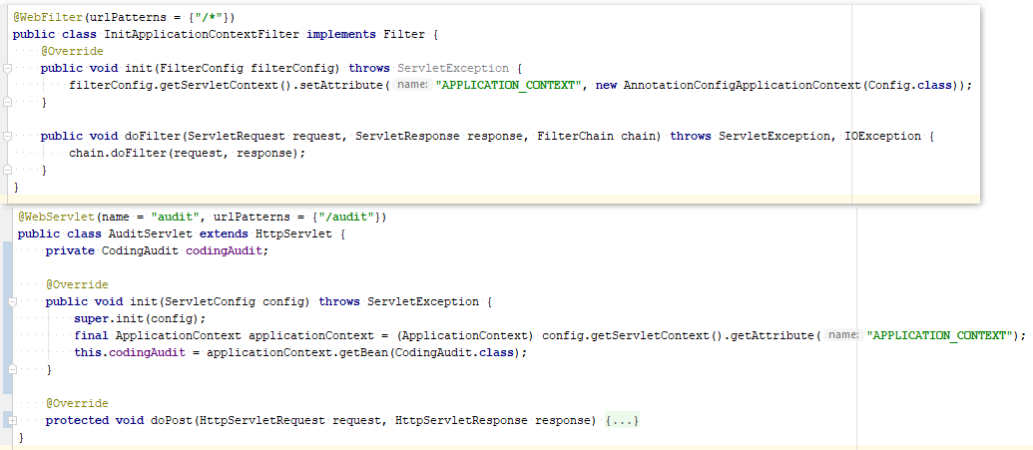
Init ApplicationContext once/injection into servlet or filter

Slide 21
Apply recommendations from personal feedbacks before starting next homework

